Slide 1
Amazon Bestselling Books Analysis Model

Slide 2

Team Alpha
Alyan Khowaja
Muhammad Hasnain
Abdul Rehman
Muzamil Shah
Jawad Hussain
Afaf Ghani
Hanzla
Muib Ur Rehman
Hooria Attas

Slide 3
Project Overview
Data Cleaning and preprocessing
EDA
Statistical Analysis and Modeling
Data Visualization
Insights and Reporting

Slide 4
Data Cleaning and Preprocessing
Remove Duplication.
Handling Missing Values
Normalization
Handling Outliers

Slide 5
Exploratory Data Analysis (EDA)
Descriptive Statistics
Distribution Analysis
Correlation Analysis
Descriptive Statistics: Means, medians, modes and standard deviations for key numerical
columns.
Distribution Analysis: Histograms and box plots for Price and Ratings.
Correlation Analysis: Heatmap to
identify relationships between variables.

Slide 6
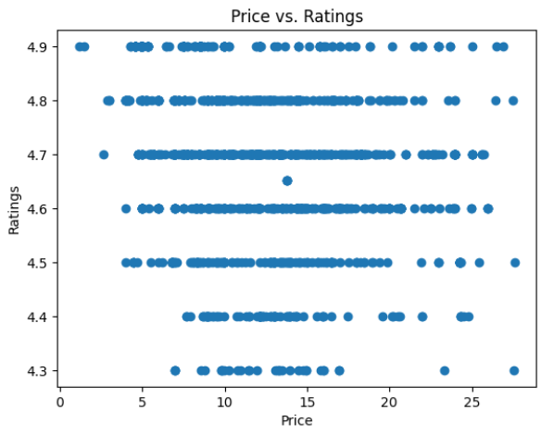
Data Visualization
Histograms: Distribution of Price and Ratings.
Box Plots: Distribution of Ratings.
Bar Charts: Distribution of Genres.
Line Graphs: Trends over time for the number of bestselling books and average ratings.
Scatter Plots: Relationships between Price and Ratings.

Slide 7
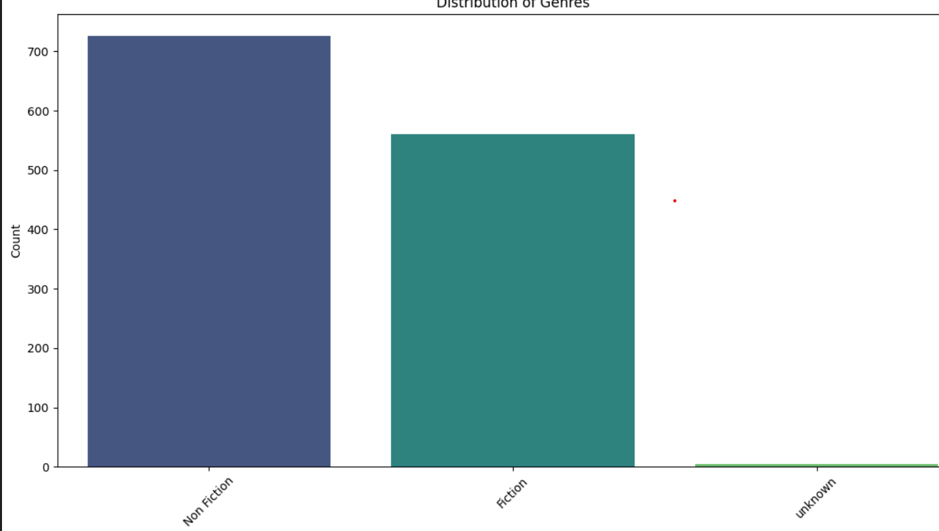
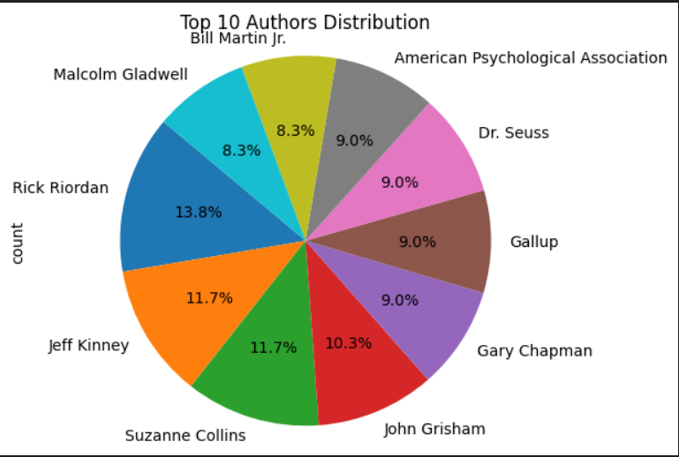
Bar and Pie Charts
Bar charts and pie charts illustrated the distribution of genres and authors

Slide 8
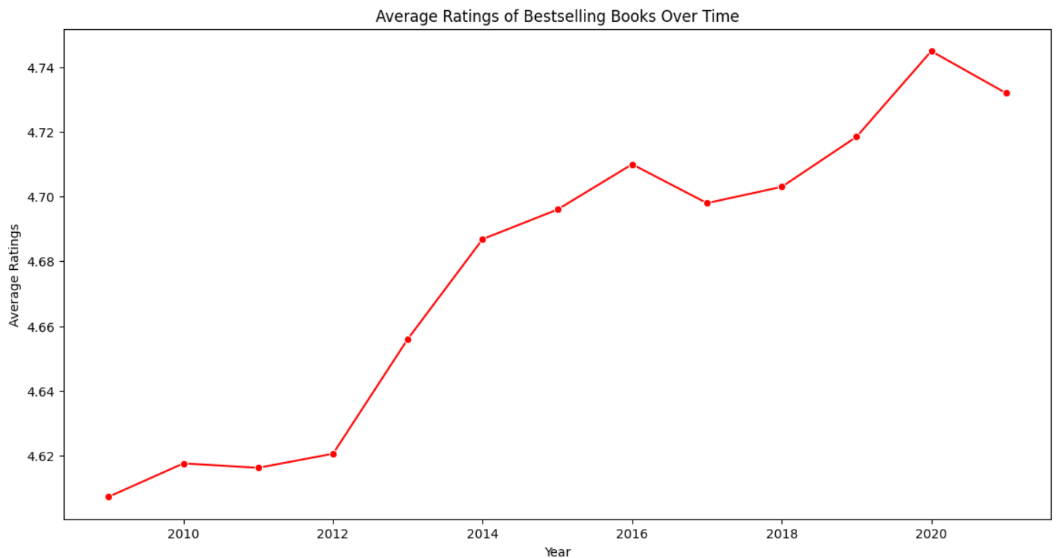
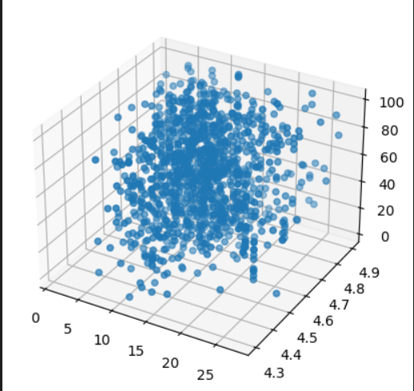
Line Graph and 3D Projection
Line graphs showed trends over time, such as changes in average ratings.
3d projection of scatter plot to visualized relationships, such as price, rating and sales rank.

Slide 9
Statistical Analysis
Hypothesis Testing:
T-tests to compare average Sales Ranks between Fiction and Non-Fiction genres.
Chi-square tests to examine the association between Genre and Sales Rank.
Regression Analysis:
Linear regression to identify predictors of Sales Rank.
Clustering:
K-means clustering to group books with similar characteristics.

Slide 10

Key Findings
Genre Analysis: Fiction and Non-Fiction have similar average Sales Ranks (T-test results).
Genre vs. Sales Rank: No significant association between Genre and top sales ranks (Chi-square test results).
Price vs. Ratings: Scatter plot indicates no strong linear relationship.
Trends Over Time: Number of bestselling books increased over the years, and average ratings remained fairly stable.
Correlation Analysis: Weak correlations between Sales Rank and other numerical features.

Slide 11
Insights and Recommendations
Pricing Strategy: Since Price and Ratings do not show a strong relationship, pricing strategies might focus on market positioning rather than perceived value.
Genre Preferences: No significant difference in Sales Rank across genres suggests diversity in reader preferences.
Marketing Focus: Focus on factors other than Genre and Price to drive sales, such as promotions and book cover designs.

Slide 12
Predictive Model
Tools And Technology
Programming Language: Python
Libraries: Pandas, NumPy, Matplotlib, Seaborn, Scikit-learn
IDE: Jupyter Notebook or any Python IDE
Regression Model: Linear regression model to predict Sales Rank based on Price, Ratings, Number of Reviews, and Genre.
Model Performance: RMSE of the model.
Clustering Analysis: Grouped books into clusters to identify potential marketing strategies for each cluster.

Slide 13
Conclusion
The analysis provided insights into factors influencing Amazon book sales, including trends over time, genre distribution, and the impact of price and ratings.

Slide 14
Thank you
Team Alpha

